Slide 1
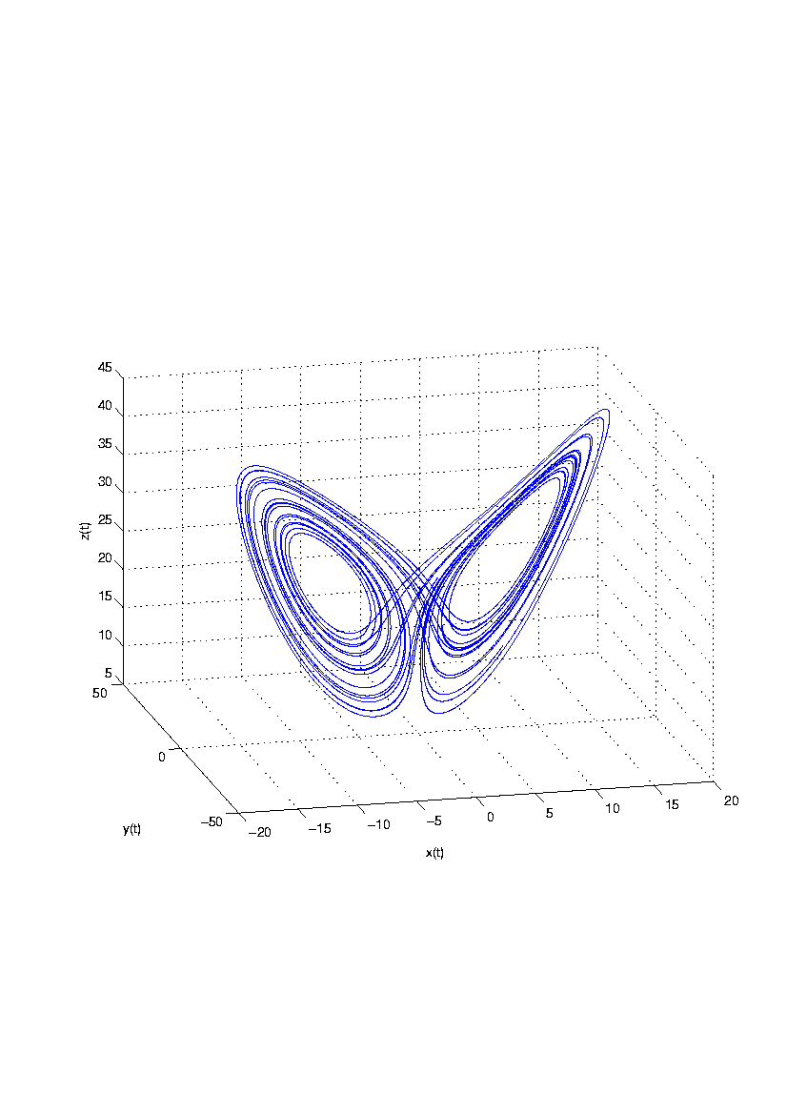
Example of poster template for use in 6th International Conference on Nonlinear Science and Complexity – NSC-2016 João da Silva National Institute for Space Research, S. J. dos Campos, Brazil silva@silva.nonlinear.br
Abstract
Insert the abstract here
Section
Insert the section content here
Figure 1: Lorenz system atractor for$σ=10,$ $ρ=28,$ $β=8/3.$

